Slide 1

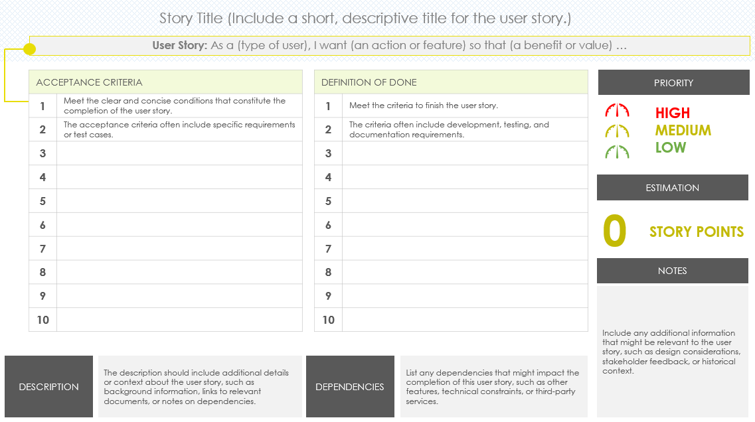
User Story with Acceptance Criteria Slide Template
User Story for:
Name

Slide 2



Story Title (Include a short, descriptive title for the user story.)
User Story: As a (type of user), I want (an action or feature) so that (a benefit or value) …
ACCEPTANCE CRITERIA
1 | Meet the clear and concise conditions that constitute the completion of the user story.
2 | The acceptance criteria often include specific requirements or test cases.
3
4
5
6
7
8
9
10
DEFINITION OF DONE
1 | Meet the criteria to finish the user story.
2 | The criteria often include development, testing, and documentation requirements.
3
4
5
6
7
8
9
10
PRIORITY
HIGH
MEDIUM
LOW
ESTIMATION
0
STORY POINTS
NOTES
Include any additional information that might be relevant to the user story, such as design considerations, stakeholder feedback, or historical context.
DESCRIPTION
The description should include additional details or context about the user story, such as background information, links to relevant documents, or notes on dependencies.
DEPENDENCIES
List any dependencies that might impact the completion of this user story, such as other features, technical constraints, or third-party services.

Slide 3
Story Title (Include a short, descriptive title for the user story.)
User Story: As a (type of user), I want (an action or feature) so that (a benefit or value) …
ACCEPTANCE CRITERIA
1 | Meet the clear and concise conditions that constitute the completion of the user story.
2 | The acceptance criteria often include specific requirements or test cases.
3
4
5
6
7
8
9
10
DEFINITION OF DONE
1 | Meet the criteria to finish the user story.
2 | The criteria often include development, testing, and documentation requirements.
3
4
5
6
7
8
9
10
PRIORITY
HIGH
MEDIUM
LOW
ESTIMATION
0
STORY POINTS
NOTES
Include any additional information that might be relevant to the user story, such as design considerations, stakeholder feedback, or historical context.
DESCRIPTION
The description should include additional details or context about the user story, such as background information, links to relevant documents, or notes on dependencies
DEPENDENCIES
List any dependencies that might impact the completion of this user story, such as other features, technical constraints, or third-party services.

Slide 4
Story Title (Include a short, descriptive title for the user story.)
User Story: As a (type of user), I want (an action or feature) so that (a benefit or value) …
ACCEPTANCE CRITERIA
1 | Meet the clear and concise conditions that constitute the completion of the user story.
2 | The acceptance criteria often include specific requirements or test cases.
3
4
5
6
7
8
9
10
DEFINITION OF DONE
1 | Meet the criteria to finish the user story.
2 | The criteria often include development, testing, and documentation requirements.
3
4
5
6
7
8
9
10
PRIORITY
HIGH
MEDIUM
LOW
ESTIMATION
0
STORY POINTS
NOTES
Include any additional information that might be relevant to the user story, such as design considerations, stakeholder feedback, or historical context.
DESCRIPTION
The description should include additional details or context about the user story, such as background information, links to relevant documents, or notes on dependencies.
DEPENDENCIES
List any dependencies that might impact the completion of this user story, such as other features, technical constraints, or third-party services.

Slide 5
Story Title (Include a short, descriptive title for the user story.)
User Story: As a (type of user), I want (an action or feature) so that (a benefit or value) …
ACCEPTANCE CRITERIA
1 | Meet the clear and concise conditions that constitute the completion of the user story.
2 | The acceptance criteria often include specific requirements or test cases.
3
4
5
6
7
8
9
10
DEFINITION OF DONE
1 | Meet the criteria to finish the user story.
2 | The criteria often include development, testing, and documentation requirements.
3
4
5
6
7
8
9
10
PRIORITY
HIGH
MEDIUM
LOW
ESTIMATION
0
STORY POINTS
NOTES
Include any additional information that might be relevant to the user story, such as design considerations, stakeholder feedback, or historical context.
DESCRIPTION
The description should include additional details or context about the user story, such as background information, links to relevant documents, or notes on dependencies.
DEPENDENCIES
List any dependencies that might impact the completion of this user story, such as other features, technical constraints, or third-party services.

Slide 6
DISCLAIMER Any articles, templates, or information provided by Smartsheet on the website are for reference only. While we strive to keep the information up to date and correct, we make no representations or warranties of any kind, express or implied, about the completeness, accuracy, reliability, suitability, or availability with respect to the website or the information, articles, templates, or related graphics contained on the website. Any reliance you place on such information is therefore strictly at your own risk.

