Slide 1


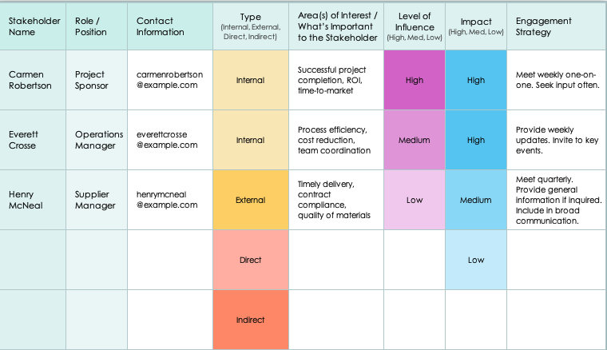
Basic Stakeholder Analysis Template Example

Slide 2
Basic Stakeholder Analysis Template Example
Stakeholder Name | Role / Position | Contact Information | Type (Internal, External, Direct, Indirect) | Area(s) of Interest / What’s Important to the Stakeholder | Level of Influence (High, Med, Low) | Impact (High, Med, Low) | Engagement Strategy
Carmen Robertson | Project Sponsor |  | Internal | Successful project completion, ROI, time-to-market | High | High | Meet weekly one-on-one. Seek input often.
Everett Crosse | Operations Manager |  | Internal | Process efficiency, cost reduction, team coordination | Medium | High | Provide weekly updates. Invite to key events.
Henry McNeal | Supplier Manager |  | External | Timely delivery, contract compliance, quality of materials | Low | Medium | Meet quarterly. Provide general information if inquired. Include in broad communication.
 |  |  | Direct |  |  | Low
 |  |  | Indirect

Slide 3
Stakeholder Analysis
Stakeholder Name | Role / Position | Contact Information | Type (Internal, External, Direct, Indirect) | Area(s) of Interest / What’s Important to the Stakeholder | Level of Influence (High, Med, Low) | Impact (High, Med, Low) | Engagement Strategy

Slide 4
Notes
Text
Stakeholder Analysis

Slide 5
DISCLAIMER Any articles, templates, or information provided by Smartsheet on the website are for reference only. While we strive to keep the information up to date and correct, we make no representations or warranties of any kind, express or implied, about the completeness, accuracy, reliability, suitability, or availability with respect to the website or the information, articles, templates, or related graphics contained on the website. Any reliance you place on such information is therefore strictly at your own risk.

