Slide 1

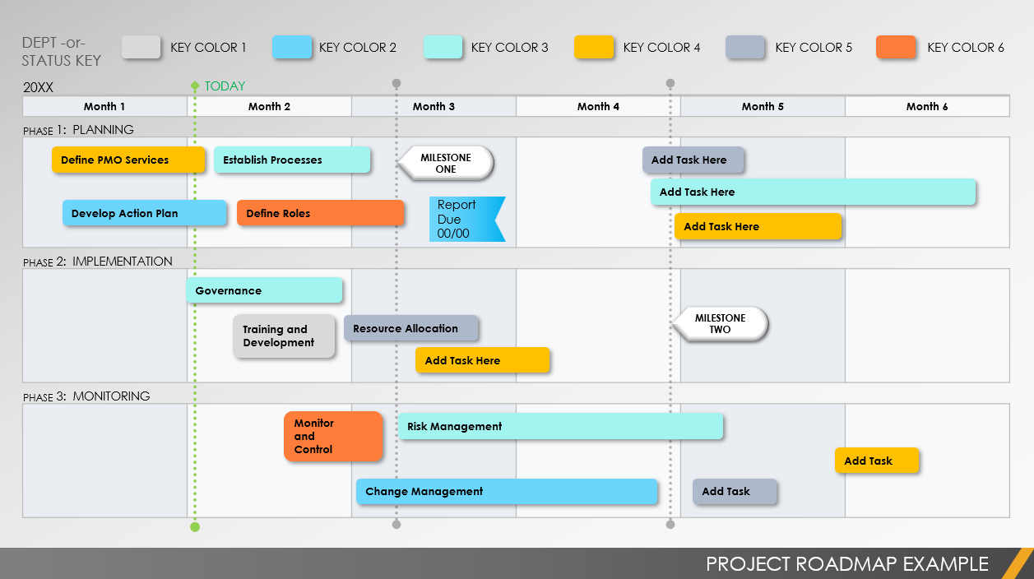
Project Timeline Template
Notes for Using This Template
Enter the months and activities represented in your plan.
Adjust bars to represent the length of time per activity.
Add Start and End Dates, Milestone Dates, and additional information within each bar or in the chart area.
Use the Color Key to assign departments, team members, or status to individual activities.

Slide 2
DEPT -or-
STATUS KEY
KEY COLOR 1
KEY COLOR 2
KEY COLOR 3
KEY COLOR 4
KEY COLOR 5
KEY COLOR 6
20XX
TODAY
Month 1 | Month 2 | Month 3 | Month 4 | Month 5 | Month 6
PHASE 1: TITLE
PHASE 2: TITLE
PHASE 3: TITLE
Add Task Here
Content Due
00/00
MILESTONE ONE
Add Task Here
CONTENT DUE 00/00
Add Task Here
MILESTONE THREE
Add Task Here
MILESTONE TWO
Add Task Here
MILESTONE FOUR
Add Task Here
CONTENT DUE
00/00

Slide 3
Assets
Add Task Here
Add Task Here
Add Task Here
MILESTONE ONE
Add Task Here
Add Task Here
Add Task Here
MILESTONE THREE
MILESTONE TWO
Content Due
00/00
MILESTONE FOUR
CONTENT DUE 00/00
CONTENT DUE
00/00
Provided by Smartsheet, Inc.

Slide 4
DISCLAIMER Any articles, templates, or information provided by Smartsheet on the website are for reference only. While we strive to keep the information up to date and correct, we make no representations or warranties of any kind, express or implied, about the completeness, accuracy, reliability, suitability, or availability with respect to the website or the information, articles, templates, or related graphics contained on the website. Any reliance you place on such information is therefore strictly at your own risk.

