Slide 1
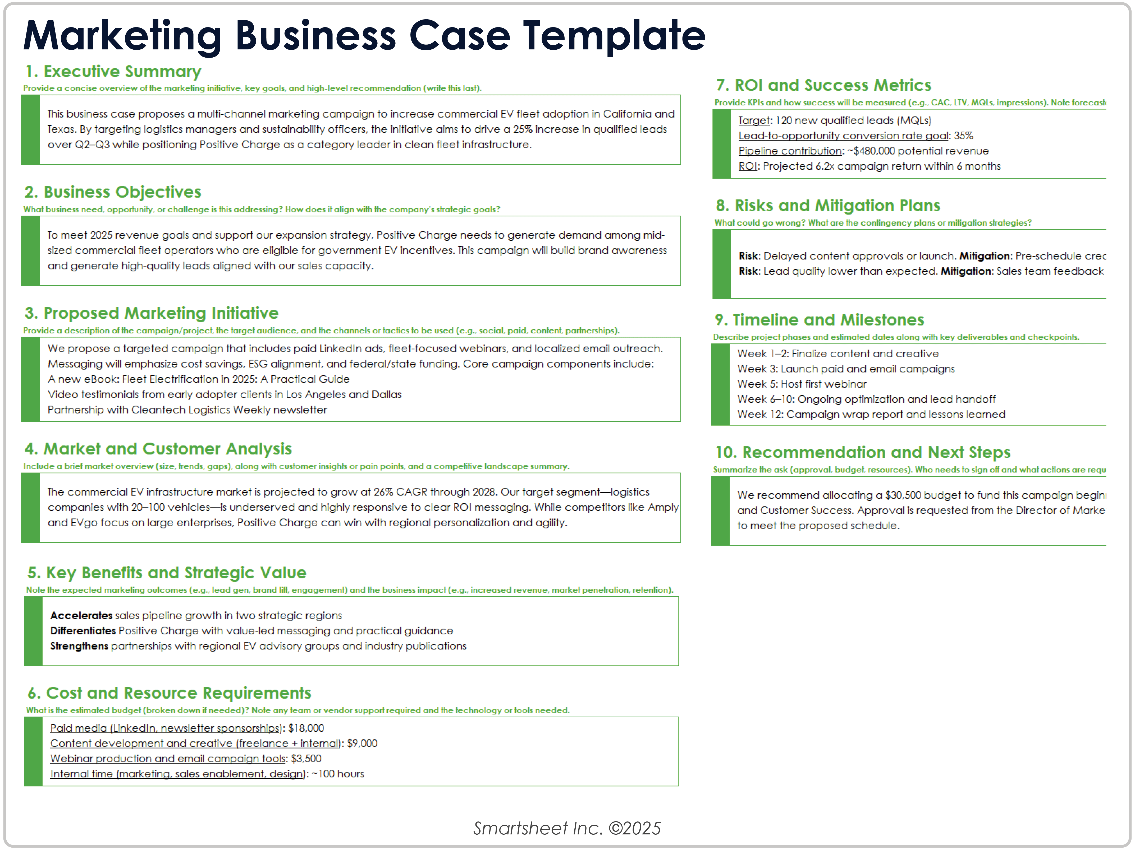
Marketing Business Case Template Example

Slide 2
1. Executive Summary
Provide a concise overview of the marketing initiative, key goals, and high-level recommendation (write this last).
 | This business case proposes a multi-channel marketing campaign to increase commercial EV fleet adoption in California and Texas. By targeting logistics managers and sustainability officers, the initiative aims to drive a 25% increase in qualified leads over Q2–Q3 while positioning Positive Charge as a category leader in clean fleet infrastructure.
2. Business Objectives
What business need, opportunity, or challenge is this addressing? How does it align with the company’s strategic goals?
 | To meet 2025 revenue goals and support our expansion strategy, Positive Charge needs to generate demand among mid-sized commercial fleet operators who are eligible for government EV incentives. This campaign will build brand awareness and generate high-quality leads aligned with our sales capacity.
3. Proposed Marketing Initiative
Provide a description of the campaign/project, the target audience, and the channels or tactics to be used (e.g., social, paid, content, partnerships).
 | We propose a targeted campaign that includes paid LinkedIn ads, fleet-focused webinars, and localized email outreach. Messaging will emphasize cost savings, ESG alignment, and federal/state funding. Core campaign components include: A new eBook: Fleet Electrification in 2025: A Practical Guide Video testimonials from early adopter clients in Los Angeles and Dallas Partnership with Cleantech Logistics Weekly newsletter

Slide 3
4. Market and Customer Analysis
Include a brief market overview (size, trends, gaps), along with customer insights or pain points, and a competitive landscape summary.
 | The commercial EV infrastructure market is projected to grow at 26% CAGR through 2028. Our target segment—logistics companies with 20–100 vehicles—is underserved and highly responsive to clear ROI messaging. While competitors like Amply and EVgo focus on large enterprises, Positive Charge can win with regional personalization and agility.
5. Key Benefits and Strategic Value
Note the expected marketing outcomes (e.g., lead gen, brand lift, engagement) and the business impact (e.g., increased revenue, market penetration, retention).
 | Accelerates sales pipeline growth in two strategic regions Differentiates Positive Charge with value-led messaging and practical guidance Strengthens partnerships with regional EV advisory groups and industry publications
6. Cost and Resource Requirements
What is the estimated budget (broken down if needed)? Note any team or vendor support required and the technology or tools needed.
 | Paid media (LinkedIn, newsletter sponsorships): $18,000 Content development and creative (freelance + internal): $9,000 Webinar production and email campaign tools: $3,500 Internal time (marketing, sales enablement, design): ~100 hours

Slide 4
7. ROI and Success Metrics
Provide KPIs and how success will be measured (e.g., CAC, LTV, MQLs, impressions). Note forecasted ROI or breakeven point.
 | Target: 120 new qualified leads (MQLs) Lead-to-opportunity conversion rate goal: 35% Pipeline contribution: ~$480,000 potential revenue ROI: Projected 6.2x campaign return within 6 months
8. Risks and Mitigation Plans
What could go wrong? What are the contingency plans or mitigation strategies?
 | Risk: Delayed content approvals or launch. Mitigation: Pre-schedule creative reviews; use agile content workflows Risk: Lead quality lower than expected. Mitigation: Sales team feedback loop + progressive profiling in CRM
9. Timeline and Milestones
Describe project phases and estimated dates along with key deliverables and checkpoints.
 | Week 1–2: Finalize content and creative Week 3: Launch paid and email campaigns Week 5: Host first webinar Week 6–10: Ongoing optimization and lead handoff Week 12: Campaign wrap report and lessons learned
10. Recommendation and Next Steps
Summarize the ask (approval, budget, resources). Who needs to sign off and what actions are required next?
 | We recommend allocating a $30,500 budget to fund this campaign beginning April 1, with cross-functional support from Sales and Customer Success. Approval is requested from the Director of Marketing and VP of Commercial Strategy by March 15 to meet the proposed schedule.

Slide 5
Marketing Business Case Template

Slide 6
1. Executive Summary
Provide a concise overview of the marketing initiative, key goals, and high-level recommendation (write this last).
2. Business Objectives
What business need, opportunity, or challenge is this addressing? How does it align with the company’s strategic goals?
3. Proposed Marketing Initiative
Provide a description of the campaign/project, the target audience, and the channels or tactics to be used (e.g., social, paid, content, partnerships).

Slide 7
4. Market and Customer Analysis
Include a brief market overview (size, trends, gaps), along with customer insights or pain points, and a competitive landscape summary.
5. Key Benefits and Strategic Value
Note the expected marketing outcomes (e.g., lead gen, brand lift, engagement) and the business impact (e.g., increased revenue, market penetration, retention).
6. Cost and Resource Requirements
What is the estimated budget (broken down if needed)? Note any team or vendor support required and the technology or tools needed.

Slide 8
7. ROI and Success Metrics
Provide KPIs and how success will be measured (e.g., CAC, LTV, MQLs, impressions). Note forecasted ROI or breakeven point.
8. Risks and Mitigation Plans
What could go wrong? What are the contingency plans or mitigation strategies?
9. Timeline and Milestones
Describe project phases and estimated dates along with key deliverables and checkpoints.
10. Recommendation and Next Steps
Summarize the ask (approval, budget, resources). Who needs to sign off and what actions are required next?
Provided by Smartsheet, Inc.

Slide 9
DISCLAIMER Any articles, templates, or information provided by Smartsheet on the website are for reference only. While we strive to keep the information up to date and correct, we make no representations or warranties of any kind, express or implied, about the completeness, accuracy, reliability, suitability, or availability with respect to the website or the information, articles, templates, or related graphics contained on the website. Any reliance you place on such information is therefore strictly at your own risk.

