Slide 1
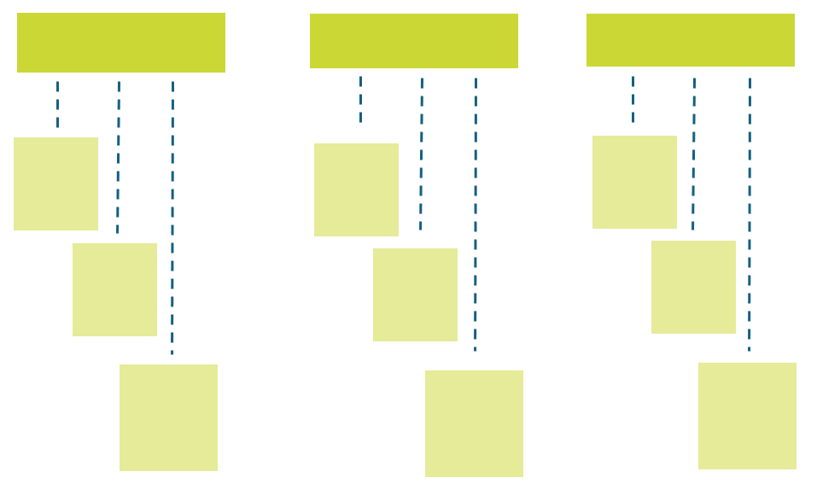
OKR Framework Template

Slide 2
What are OKRs?
Objectives and Key Results (OKRs) are a goal-setting framework that helps individuals, teams, and organizations focus on what matters most.
OKR Formula:
“I will (objective) as measured by (key results).”
Objective
A clear, qualitative statement of what you want to achieve.
Key Result
Key Result
Key Result
3–5 measurable outcomes that define success for the objective.

Slide 3
Why Use OKRs?
Benefits | When to Use | When Not to Use
The OKR framework aligns everyone’s work to shared priorities. The framework increases focus and accountability. OKRs encourage transparency across teams and departments. Using OKRs drives measurable outcomes instead of vague activity tracking. | Use OKRs at the start of a quarter or a planning cycle to set clear goals. Use OKRs when you need to align cross-functional teams on high-impact priorities. | Do not use OKRs to track routine tasks or low-level to-do lists. Do not use OKRs for outcomes that can’t be meaningfully measured.

Slide 4


OKR Best Practices
Aim High: Set objectives that are ambitious yet achievable.
Limit Scope: Set 3–5 key results per objective.
Be Specific: Avoid vague language — use measurable terms.
Track Regularly: Review OKRs weekly or biweekly.
Adjust When Needed: Modify key results if priorities change mid-cycle.
OKR Common Pitfalls to Avoid
Writing key results as tasks instead of measurable outcomes
Setting too many OKRs, diluting focus
Failing to communicate OKRs across the team

Slide 5
OKR Examples
Company Level (Strong) | Team Level (Strong) | Individual Level (Weak) Weak because the KRs are vague, unmeasurable, and lack time frames.
OBJECTIVE: Expand brand presence in new markets.
OBJECTIVE: Improve product onboarding experience.
OBJECTIVE: Get better at marketing.
KEY RESULT: Launch in three new regions by Q3.
KEY RESULT: Reduce onboarding time from 10 days to 5.
KEY RESULT: Read articles about SEO.
KEY RESULT: Increase web traffic by 40%.
KEY RESULT: Increase completion rate of onboarding checklist to 90%.
KEY RESULT: Post on social media more often.
KEY RESULT: Achieve a Net Promoter Score of 70+ in new markets.
KEY RESULT: Achieve a customer satisfaction score of 8.5/10.
KEY RESULT: Try to learn Google Ads.

Slide 6
OKR Do’s and Don’ts
Do | Don’t
Write measurable key results. Limit OKRs to a few high-impact goals. Review and update regularly. Align OKRs to higher-level goals. | Write vague, task-based key results. Overload with too many objectives. Set OKRs and forget them for the whole cycle. Work in isolation from company strategy.

Slide 7
Objective Template
Alignment Tips: Vertical alignment ensures individual OKRs support team OKRs, which in turn align to company-level OKRs. Horizontal alignment illustrates sharing OKRs across teams to spot dependencies and avoid duplication. (Consider a simple diagram showing company OKRs → team OKRs → individual OKRs.)
Template:
Objective: (What do you want to achieve? Keep it qualitative and inspiring.)
Key Result: (What metric will prove successful? Use numbers, percentages, or concrete milestones.)
Scoring Guidelines
Reflect on scores at the end of each cycle to identify successes and areas for improvement.
0.0–0.3 = Not achieved 0.4–0.6 = Partially achieved 0.7–1.0 = Fully achieved/exceeded

Slide 8
Reflection Questions
What worked well? | What challenges did we face? | What lessons can we apply next cycle? | Which OKRs should we keep, revise, or replace?
Content | Content | Content | Content
Provided by Smartsheet, Inc.

Slide 9
DISCLAIMER Any articles, templates, or information provided by Smartsheet on the website are for reference only. While we strive to keep the information up to date and correct, we make no representations or warranties of any kind, express or implied, about the completeness, accuracy, reliability, suitability, or availability with respect to the website or the information, articles, templates, or related graphics contained on the website. Any reliance you place on such information is therefore strictly at your own risk.

